Slide 1
PRDA-04 - Job Market Analysis

Slide 2
Objective of the Project
The goal of this project is to analyze the job market trends for positions by analyzing job data and to analyze all the feature and derive insights that can inform job seekers and employers.
Dataset details : 742 rows and 42 columns

Slide 3
Tools Used and Purpose
1.SQL- Data Extraction and exploring the data table.
2.Power BI - For Visualizations and Creating interactive dashboard.
3.Power Query Editor – For exploring and cleaning data by removing duplicates and error values

Slide 4
Data Cleaning Process
Removed Column with all null values as it did not have any importance.
Replaced -1 values to null values and imputed them with necessary values.
Imputed wrong range of values with the right values.

Slide 5
Analysis performed
States with most jobs.
Average min and max salaries in different states.
Average salary in different states.
Top 5 industries with most data science postings.
Companies with maximum job openings.
Job title with most job openings.

Slide 6
Analysis performed
Salary of job titles with most number of jobs.
Skills required by companies as per job title
Relationship between average salary and education.
Companies offering highest salary.
Industries with maximum salary

Slide 7
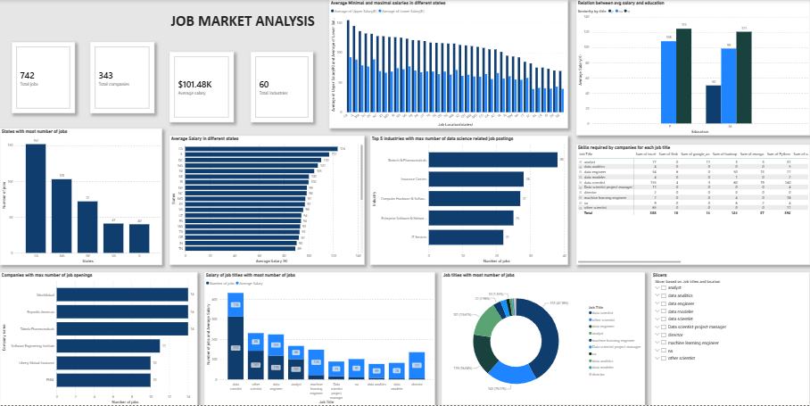
Dashboard

Slide 8
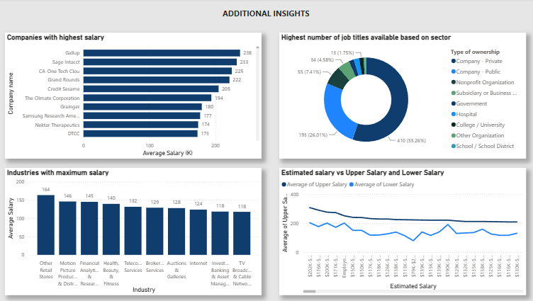
Dashboard

Slide 9
Insights
California, Massachusetts, and New York recorded the highest demand for Data Science professionals.
Salary levels varied across states, with California and Illinois offering some of the highest average salaries.
The IT industry accounted for the largest share of job opportunities.
Data Scientist was the most frequently advertised job role across the dataset.
Python, SQL, Excel, and cloud technologies were among the most in-demand technical skills.
Companies prefer candidates with diverse technical skill sets, indicating increasing demand for multi-skilled professionals.

Slide 10
Recommendations
Focus recruitment in high-demand states to attract qualified talent.
Offer competitive salary packages aligned with regional market trends.
Prioritize candidates with strong technical skills, particularly Python, SQL, cloud technologies, and data visualization tools.
Invest in continuous upskilling and certification programs to meet evolving industry requirements.
Candidates should build a broad technical skill set to improve employability across industries.

Slide 11
Challenges
Missing values (-1).
Inconsistent data.
Data cleaning.
Understanding salary ranges.

Slide 12
Conclusion
Analyzed the job market data by using SQL and Power Bi.
Identified key trends in the job, demand, skills, salaries, industries etc.
Built interactive dashboard to support the data driven insights and decision making.

